Slide 1
Pace STEM Camp 2021 Final Project
Team Matrix (2a): Sailaja, May, Daniel, Vraj, Xavier
Notes:
Sailaja

Slide 2
Table of contents
01
02
03
04
Initial Data
Relationships & Factors
BOP Data Analysis
Data correlation and Oyster life factors
Results & Interpretation
Reflection
Findings and our thoughts
Thoughts on the project and program
Notes:
Sailaja

Slide 3
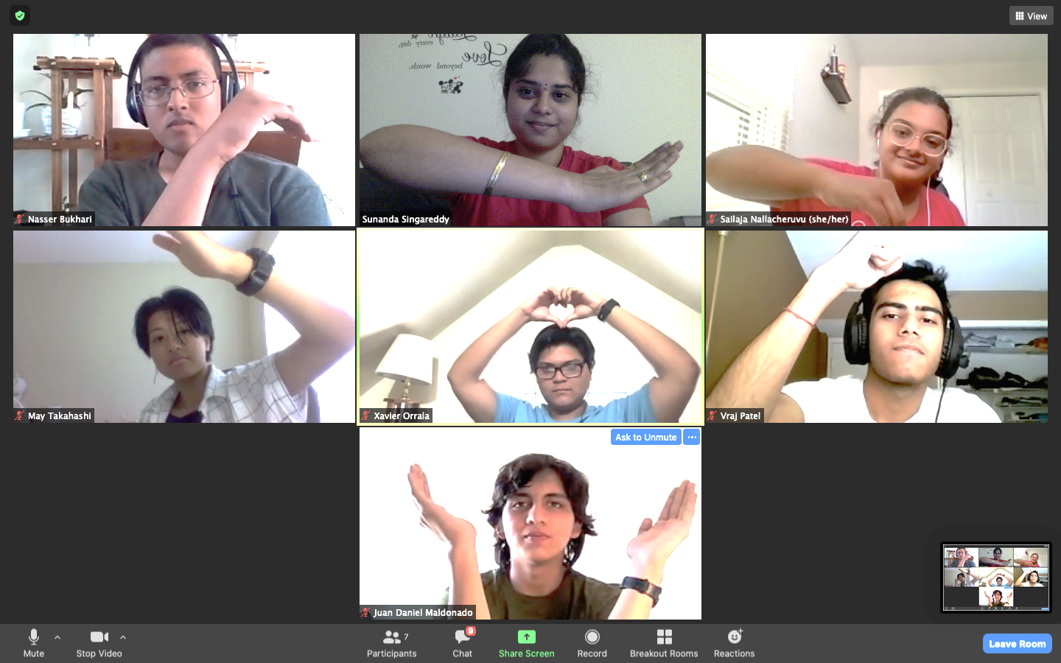
Team Matrix
Team pictures go here
Nasser Bukhari
Sunanda Singareddy
Sailaja Nallacheruvu
May Takahashi
Xavier Orrala
Vraj Patel
Daniel Maldonado
Notes:
Sailaja

Slide 4
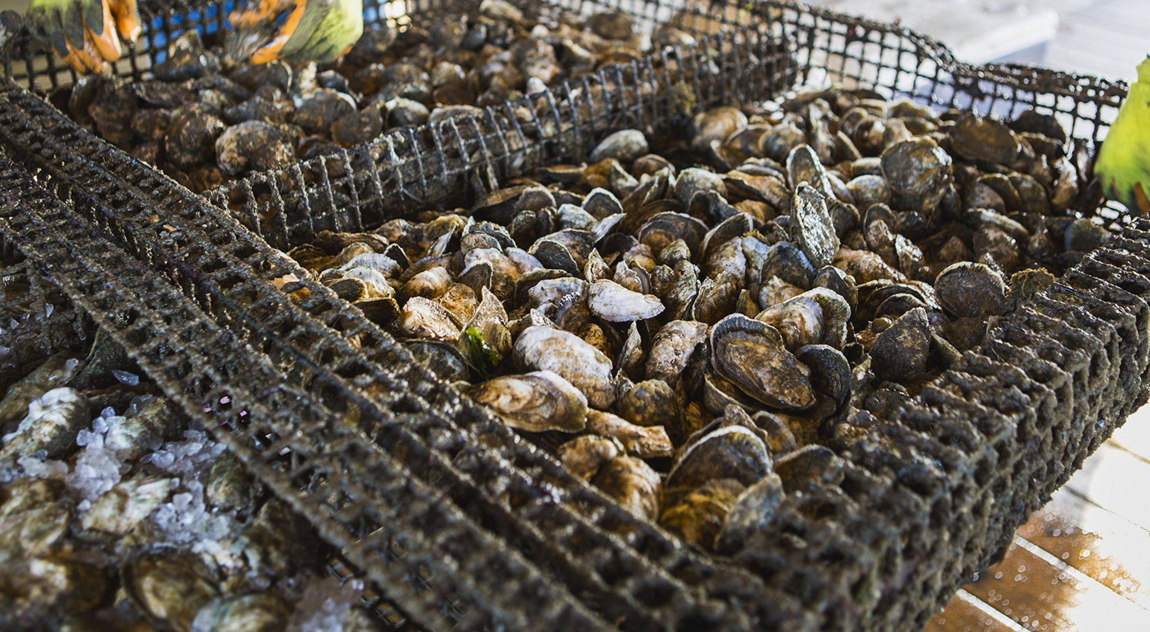
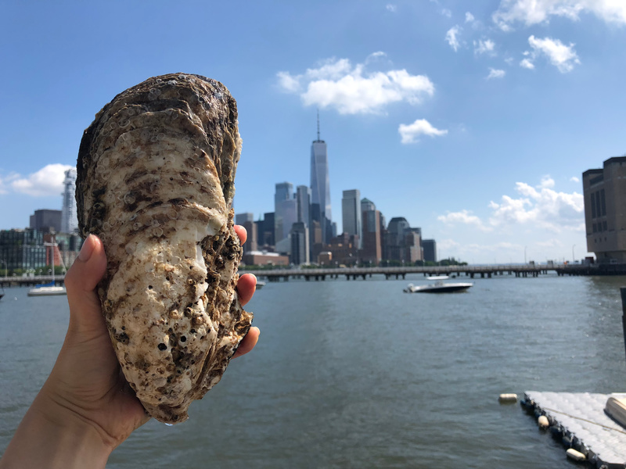
Oysters in New York
Oysters
Used to be abundant in NYC
Help to clean and filter the water surrounding it
BOP helps restore Oyster presence and collects data
Turbidity
Relative clarity of the liquid
Cloudier water = Higher turbidity & more scattered light
Dissolved Oxygen Levels
The concentration of oxygen in the water at any given time
Usually measured in PPM
Strong indicator of water quality/health
Notes:
Sailaja

Slide 5
How does the turbidity of the water correlate to dissolved oxygen levels?
Notes:
Xavier

Slide 6

Initial Data
How we came up with our question and data from the Billion Oyster Project
Notes:
Xavier

Slide 7
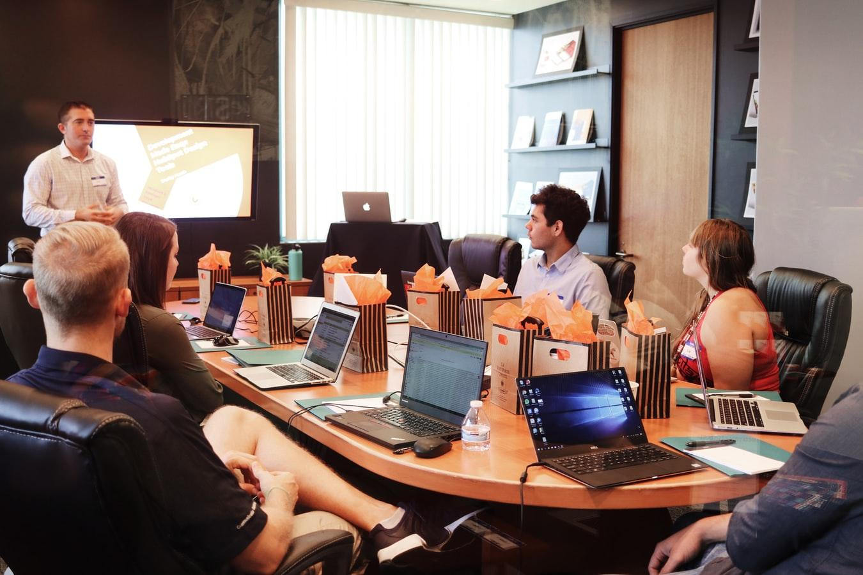

How we derived our question
Talking with scientist Brett F. Branco
Change from original question - Lack of Data
How can we increase the effectiveness of oysters based on their life span and the amount of water they filter?
Coded using Python in Google Colab
Notes:
Xavier

Slide 8
Relationships & Factors
What trends did we find? How did we find these trends?
Notes:
Vraj

Slide 9
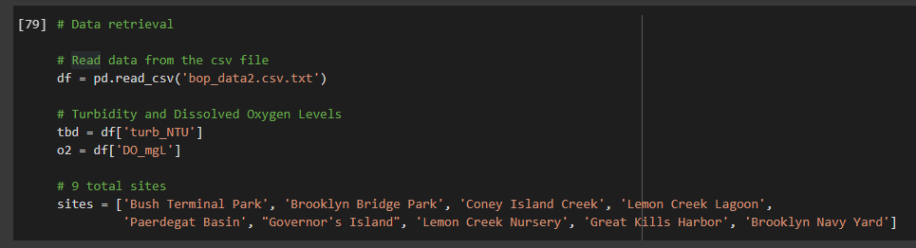
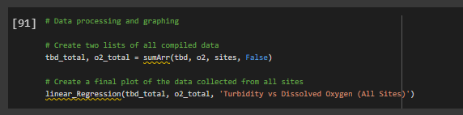

Slide 10
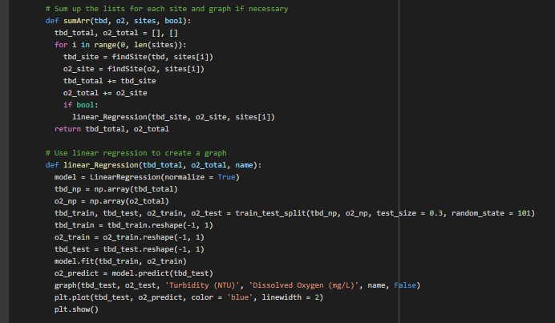

Slide 11
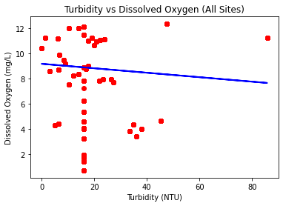
Turbidity and Dissolved Oxygen Levels (DOL)
(All Locations)
Notes:
Vraj

Slide 12
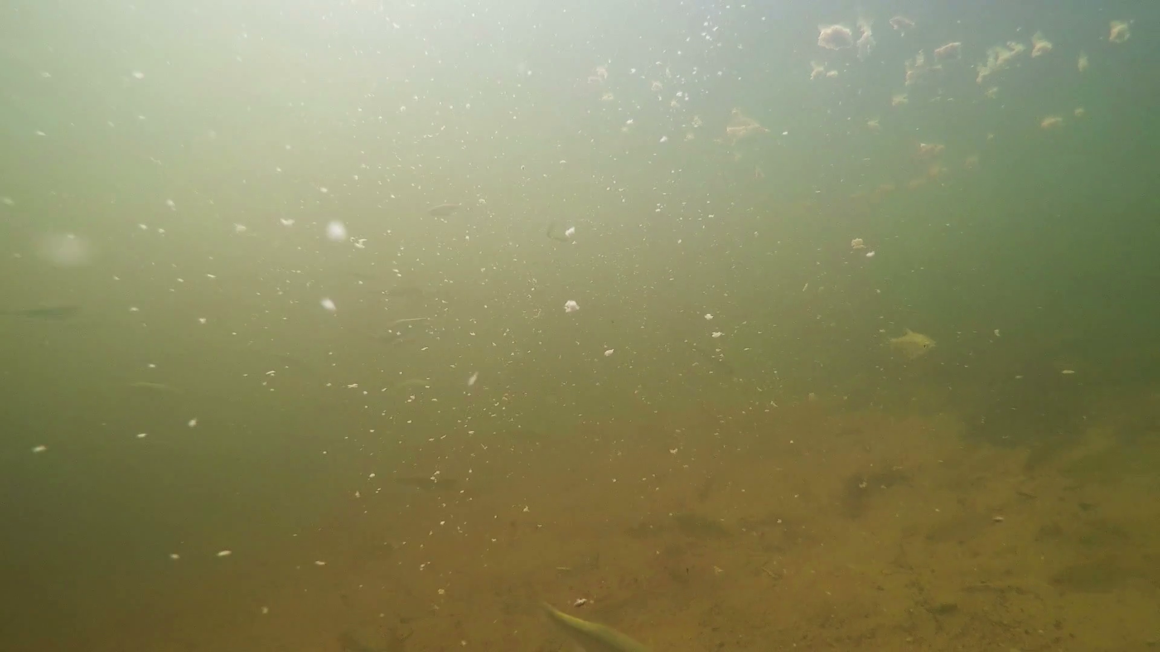
Turbidity and Dissolved Oxygen Levels (DOL)
(All Locations)
What does this mean?
Negative Correlation
As one increases, the other decreases (inverse correlation)
Notes:
Vraj

Slide 13



Turbidity and Dissolved Oxygen Levels (DOL)
Other factors
Notes:
Daniel
Some other factors that affected these oysters was temperature, location and time.

Slide 14
Results & Interpretation
What did we find? What do we think of the results we found?
Notes:
Daniel

Slide 15
Final Conclusion
The main point we came across was:
Turbidity and DOL have an inverse relationship. Graph shows weak negative correlation
There are other factors that we were unable to test that could also impact results → could be done with more time + knowledge
Notes:
Sailaja

Slide 16
Final Thoughts
Final thoughts. What did we think of the STEM camp? What did we learn from the time we spent here?
Notes:
Daniel

Slide 17



Reflection
Our thoughts
Things we did well
Ways to improve
Notes:
Daniel
Our thoughts:
STEM camp was both stressful, but informative.
Overall, it was fun and we all enjoyed our time!
Things we did well:
The team stayed on task and knew what to do and when we needed to do it
Ways to improve:
We can ask more questions, communicate more, and have more knowledge on the topics.

Slide 18
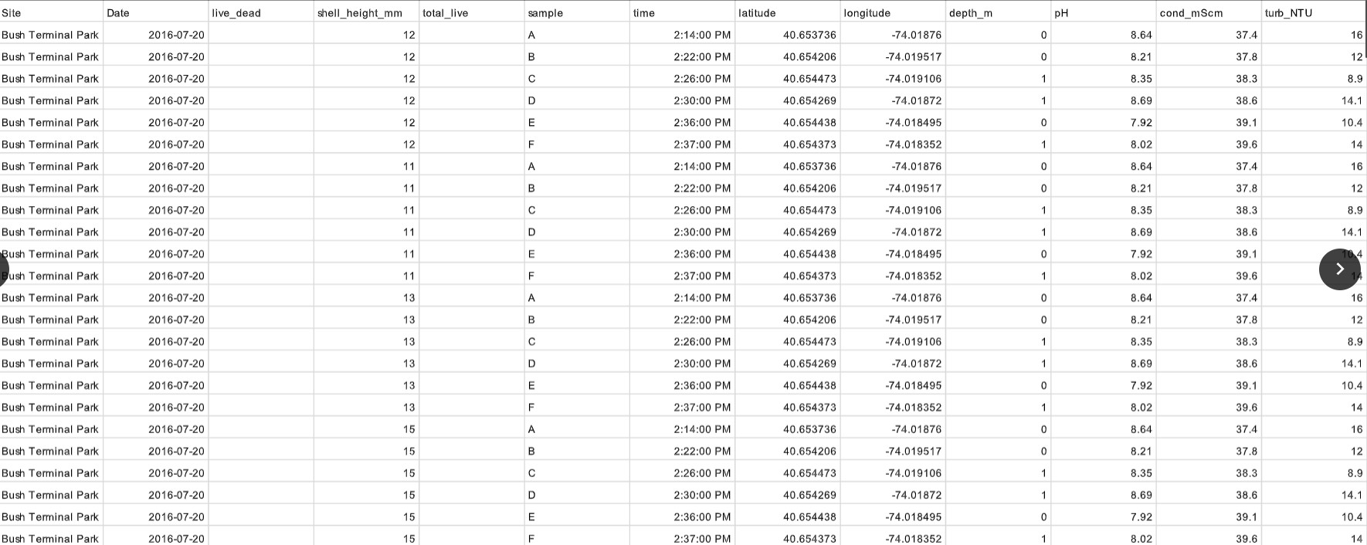
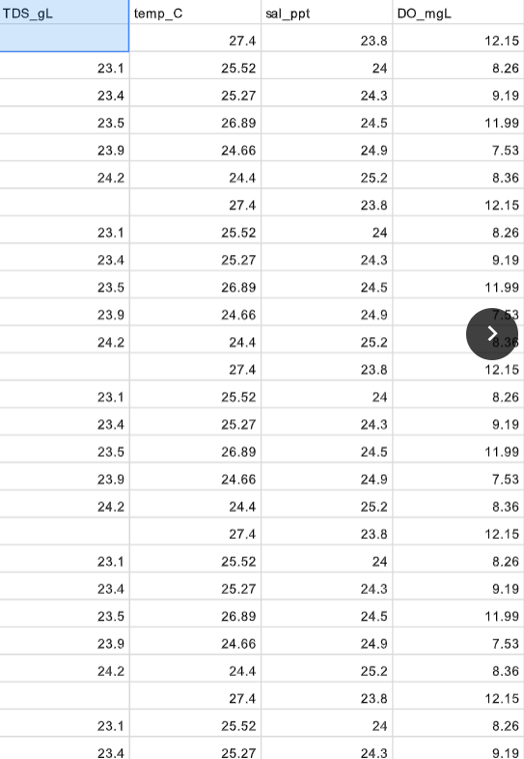
Sources Used
Billion Oyster Project data, compiled by BOP and STEM Camp staff
General online reports
Notes:
Xavier

Slide 19
Thank you for your attention
Notes:
Xavier

